Slide 1
Google Big Query
Overview
KROLL BOND RATING AGENCY, INC

Slide 2
Agenda
Introduction
Pete
Sign Up
Storing Data
Retrieving Data
Additional Detail
Yash
BigQuery under the hood
Columnar Storage
Query Execution
RMBS
Ravi
Live demo
Schema Creation
Loading

Slide 3
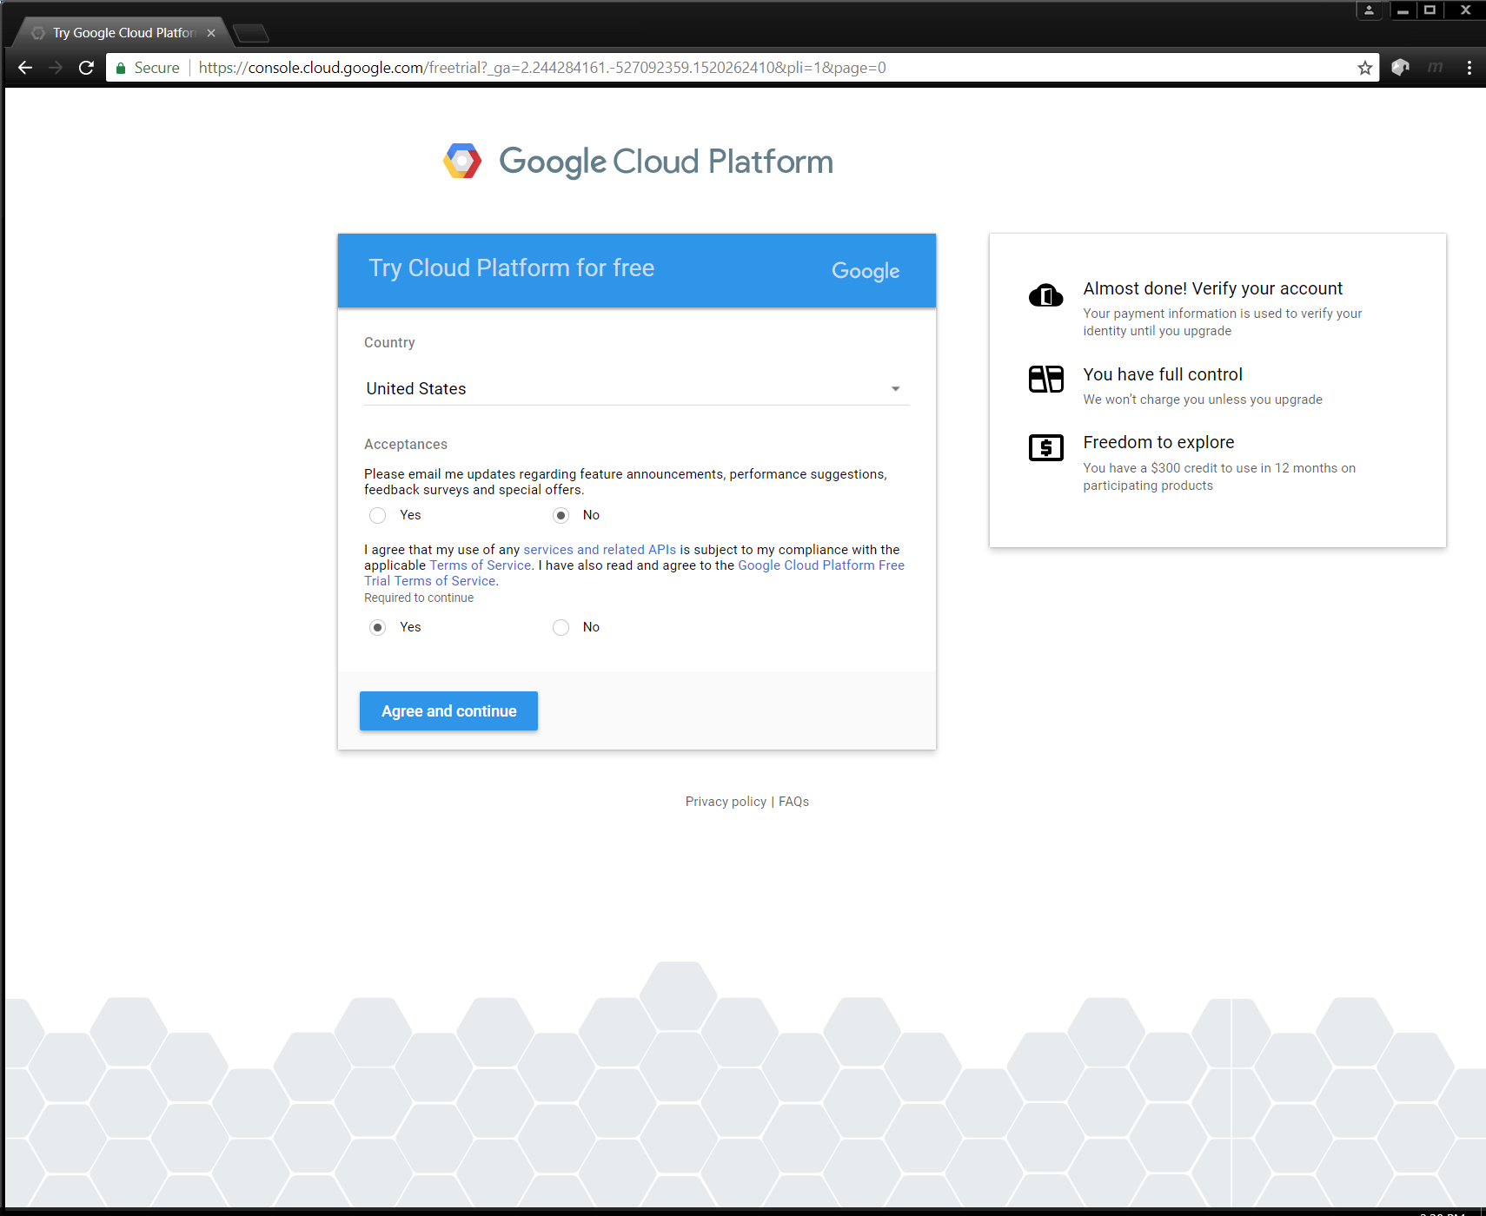
Getting Started – Signup 1

Slide 4
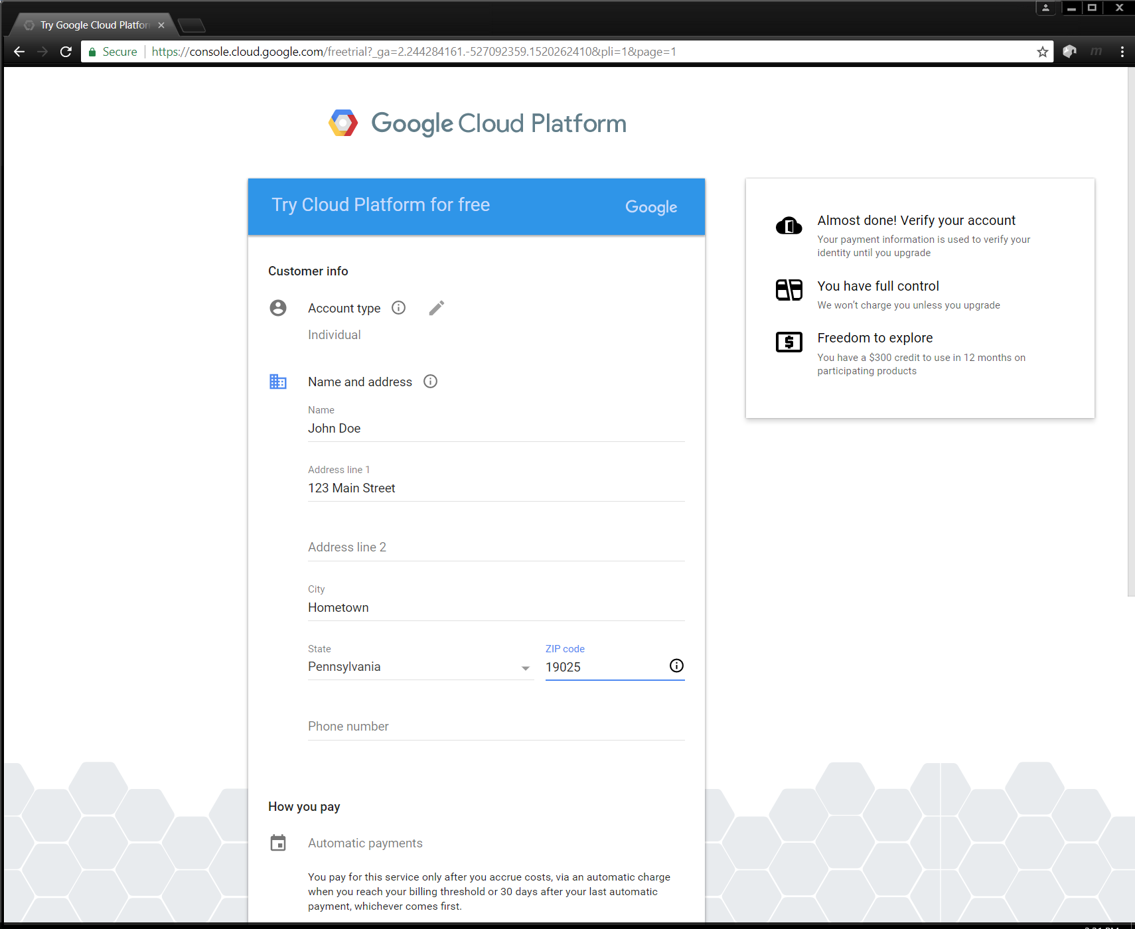
Getting Started – Signup 2

Slide 5
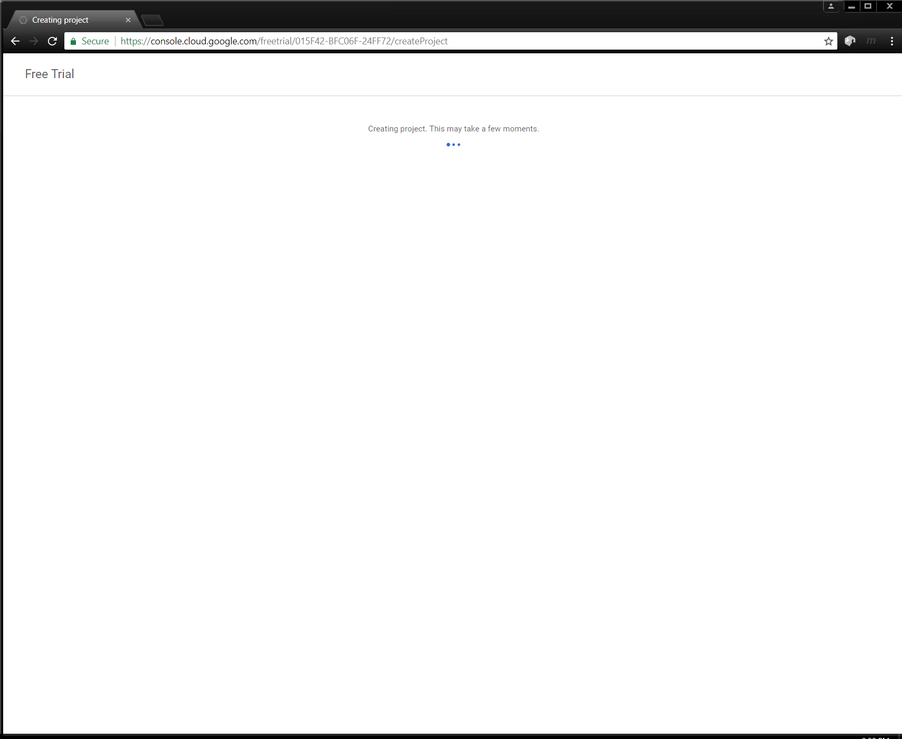
Getting Started – Signup Done

Slide 6
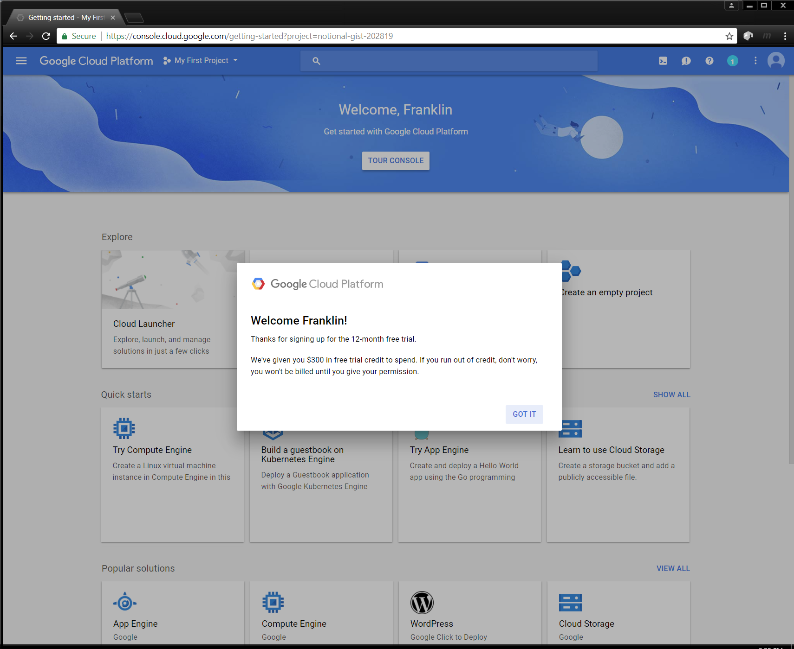
Getting Started – You are in

Slide 7
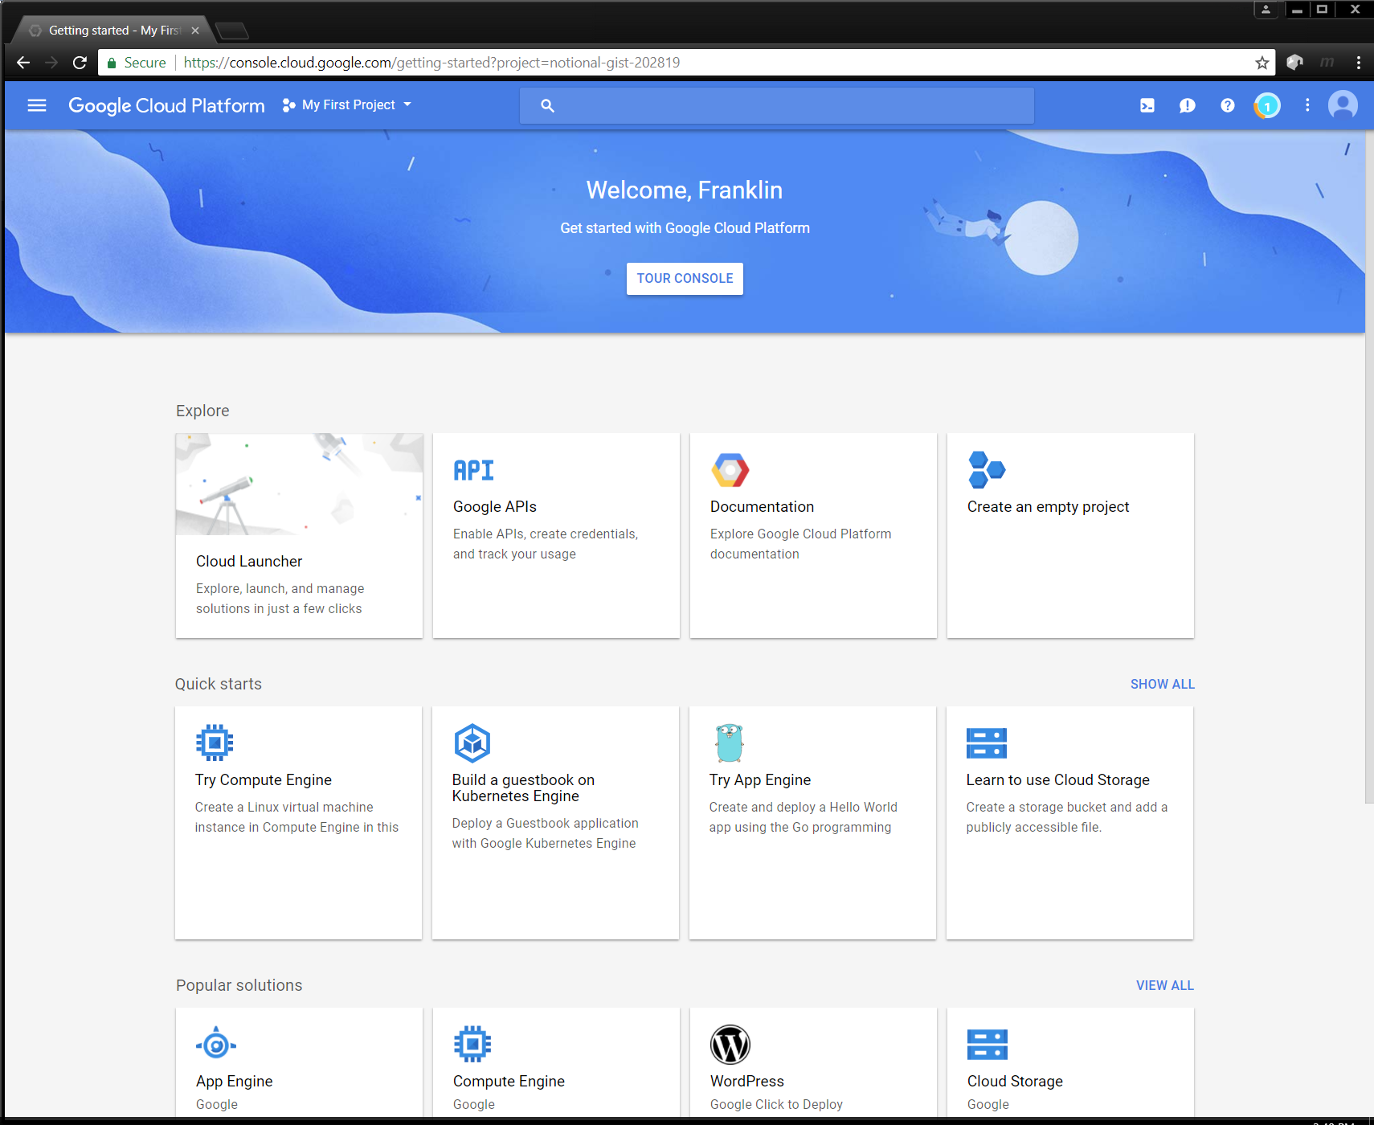
Getting Started – Start the Tour

Slide 8
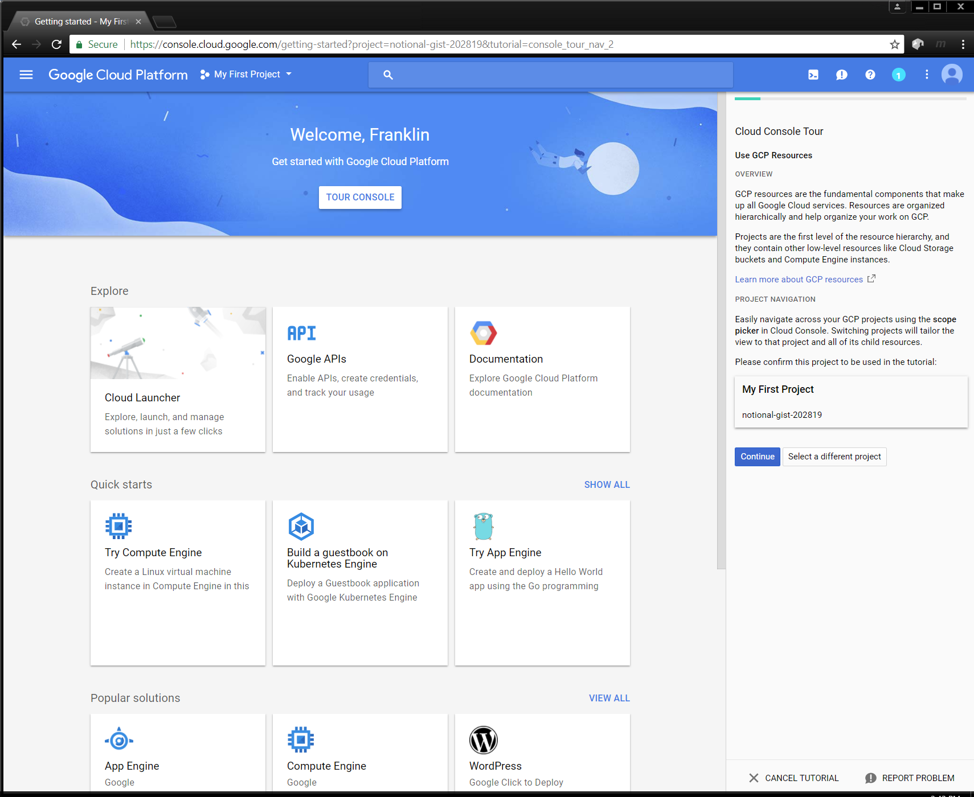
Getting Started – Continue the Tour

Slide 9
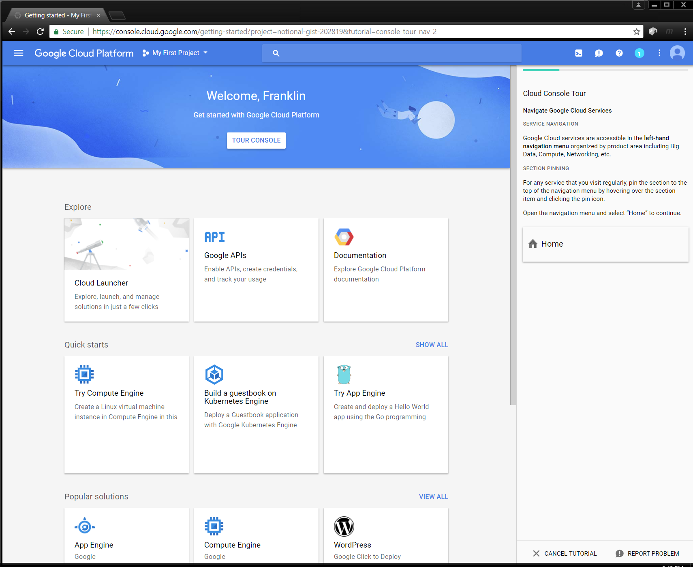
Getting Started – Go Live

Slide 10
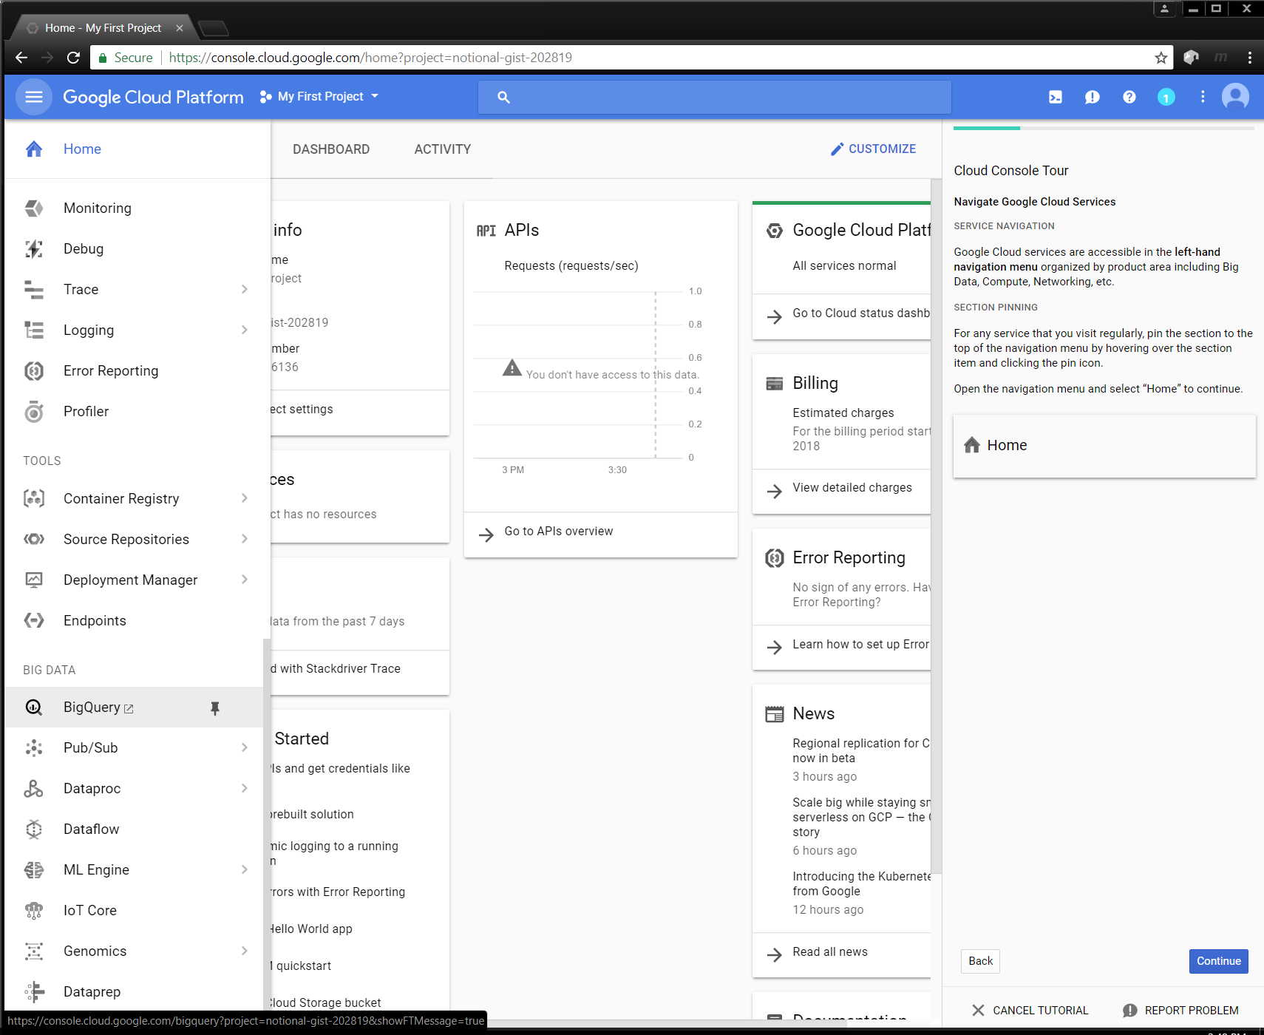
Getting Started – Scroll Down on the Left

Slide 11
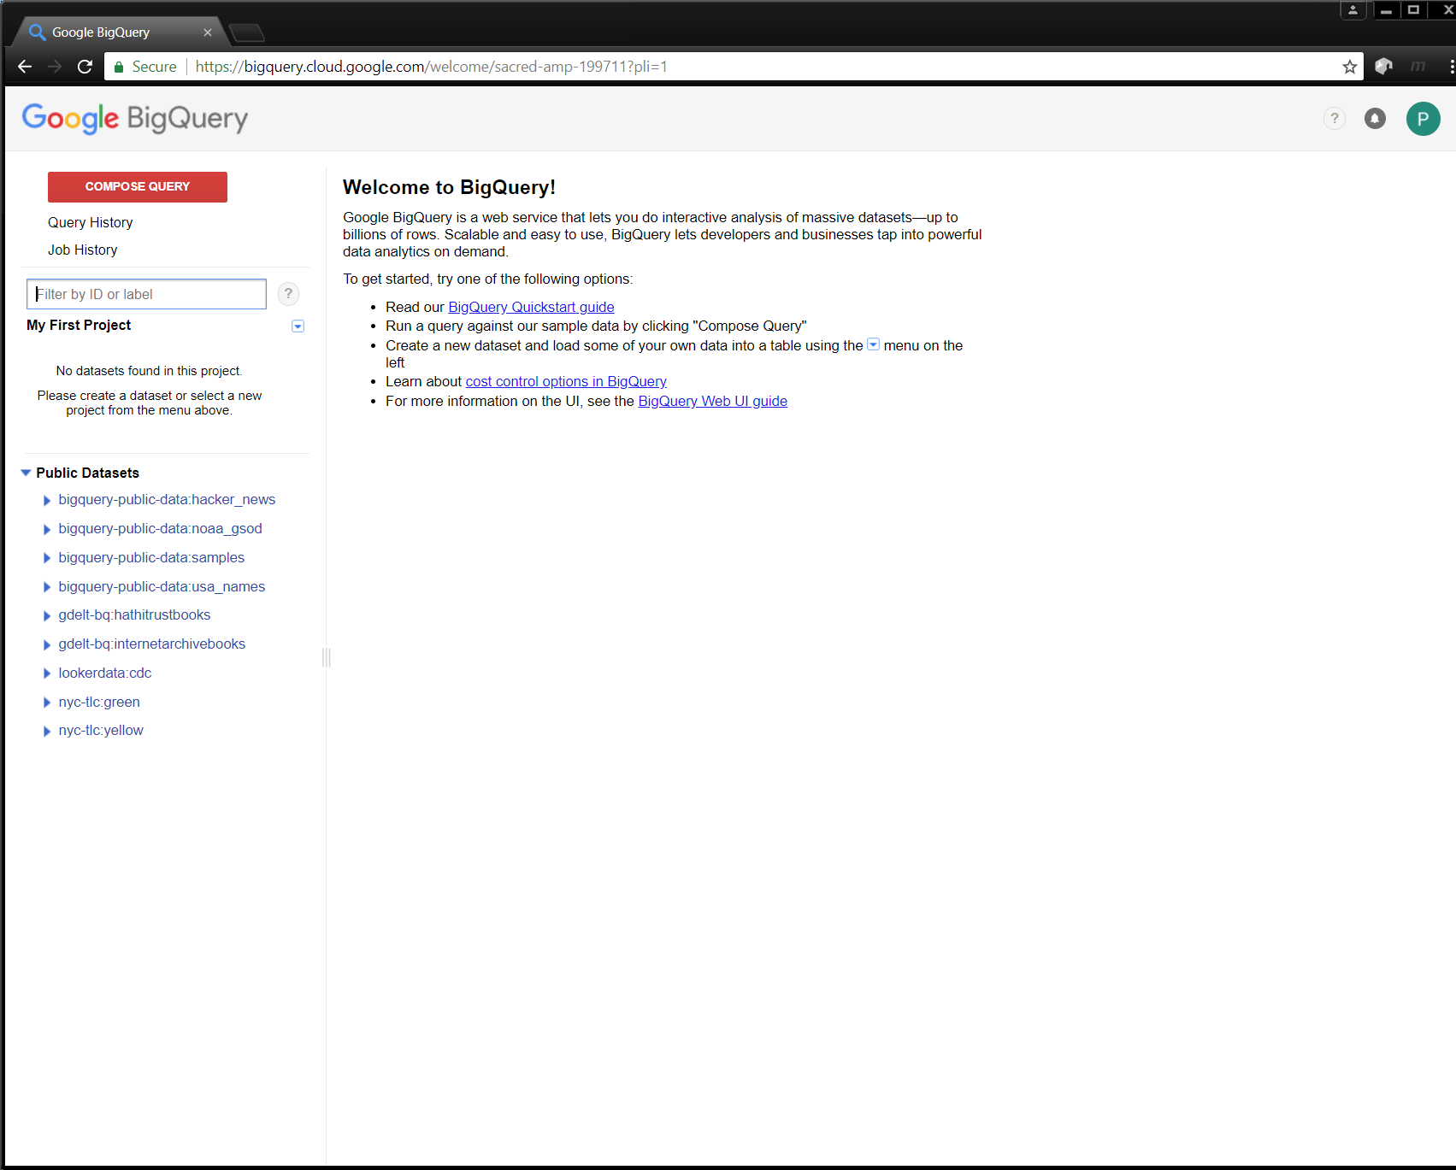
Getting Started – Finally BigQuery
Organization
Projects
Top-level
Datasets
One or more tables
Tables
Row-column structures
History
Query and Job

Slide 12
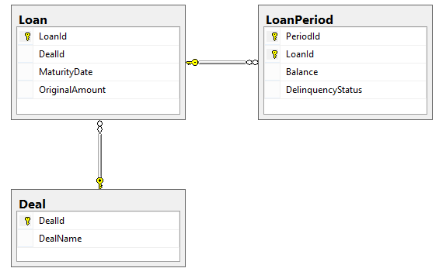
Getting Started - Preliminaries
Our Whiteboard Exercise

Slide 13
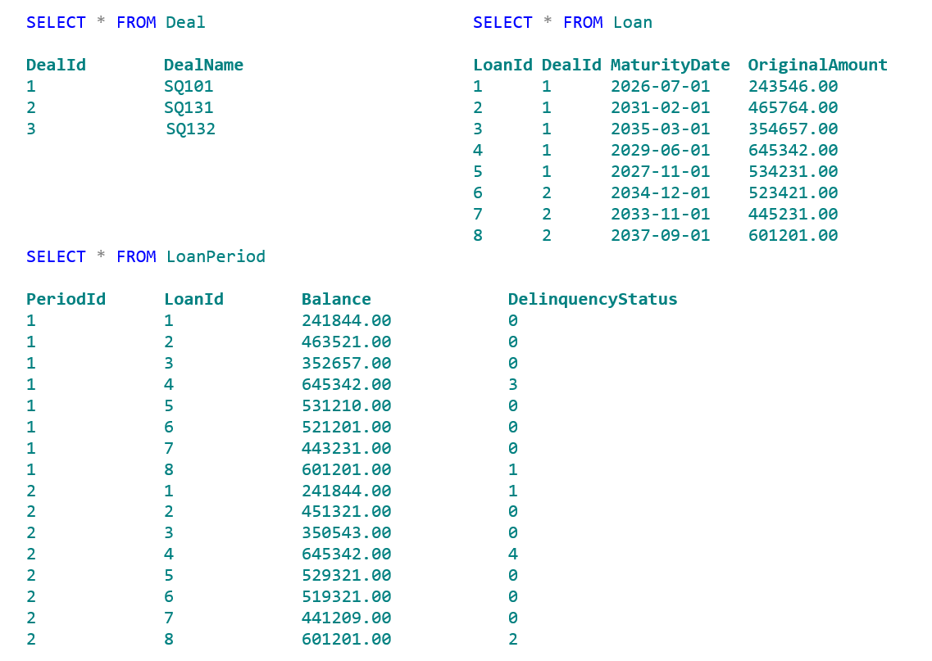
Getting Started - Preliminaries
Our Whiteboard Exercise

Slide 14
Getting Started - Preliminaries
Our Whiteboard Exercise
Using this data please use the whiteboard to construct these queries:
Query 1:
What was the average loan balance for each deal during period 2?
Query 2:
Which loans had a change in delinquency status between period 1 and period 2?

Slide 15
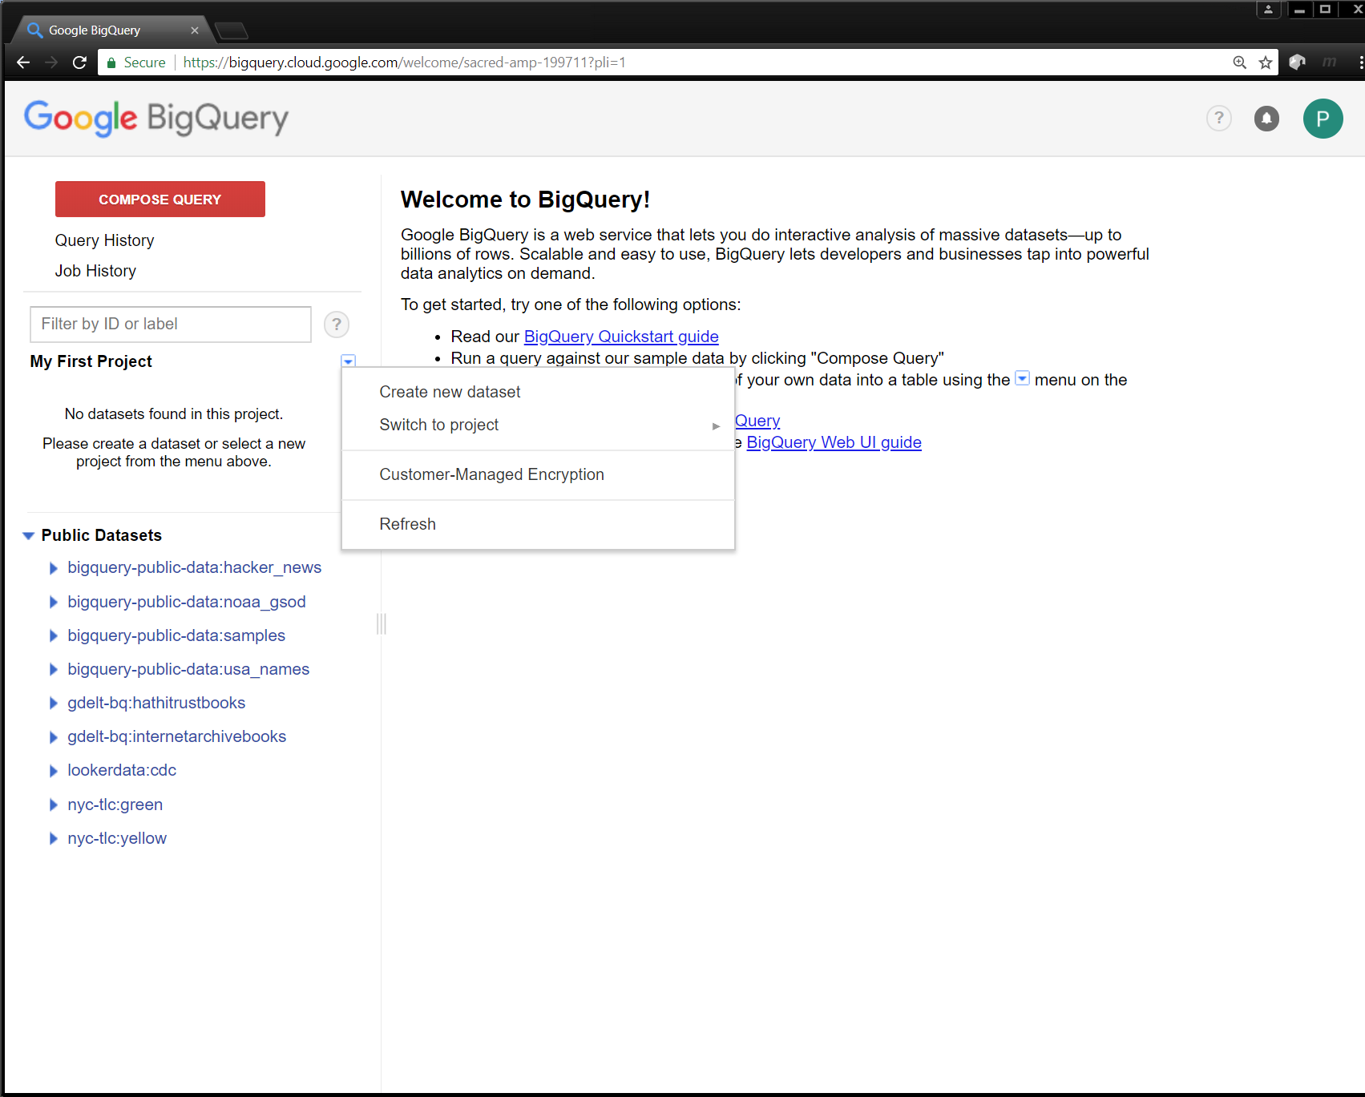
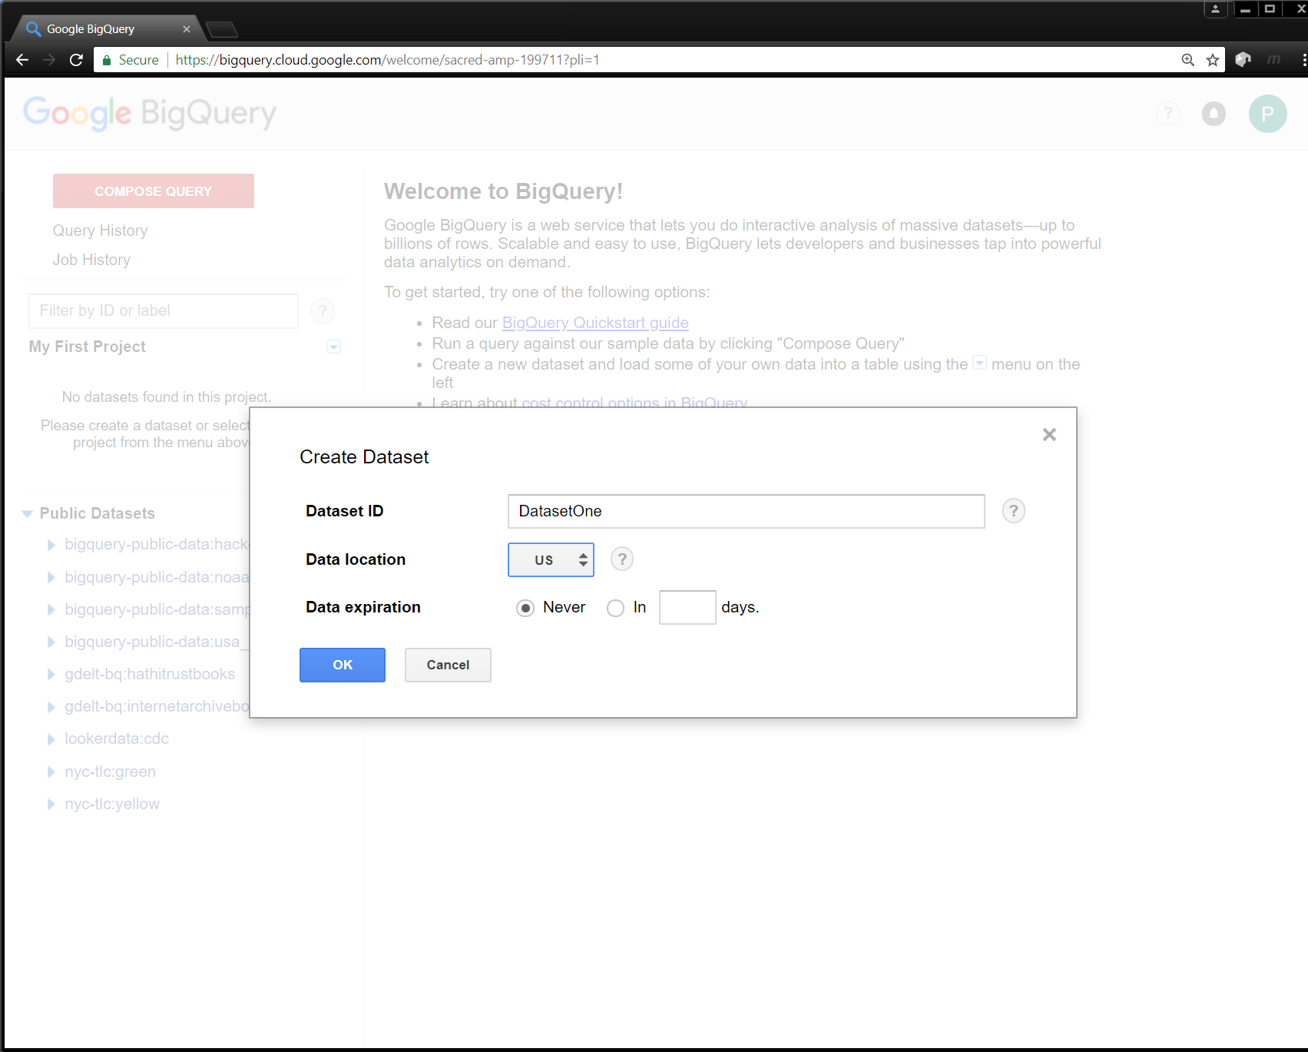
Getting Started – Start Building the Levels

Slide 16
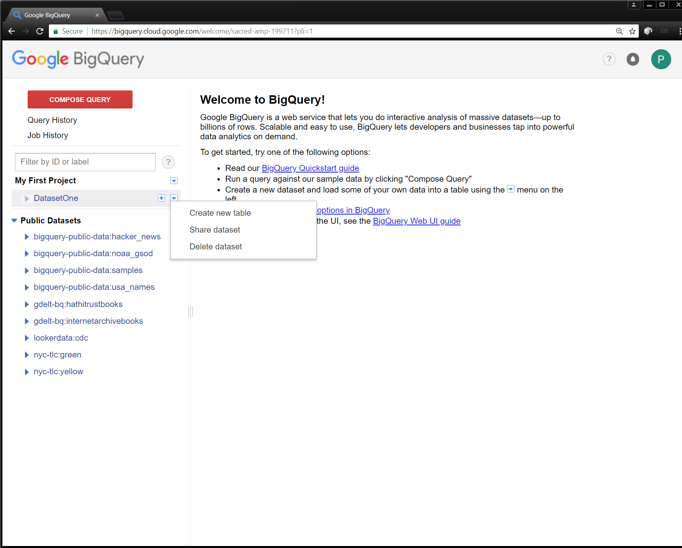
Table Creation – Add Tables

Slide 17
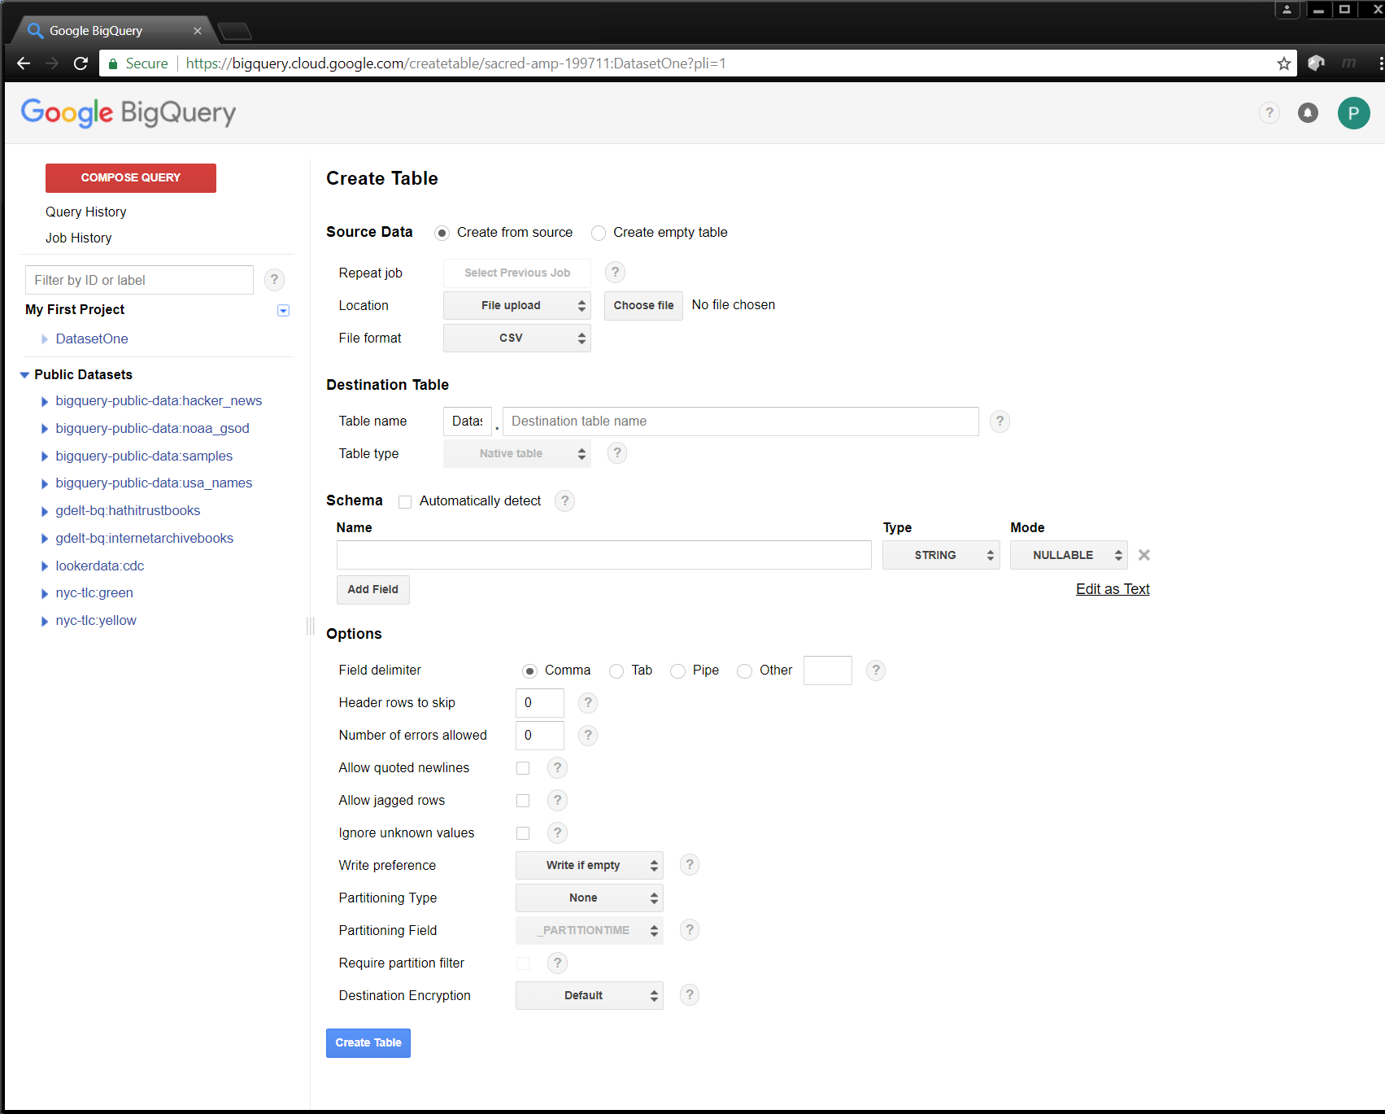
Table Creation – Add Tables via the GUI
Typical Rules Apply
Repeat as needed
And you are done

Slide 18
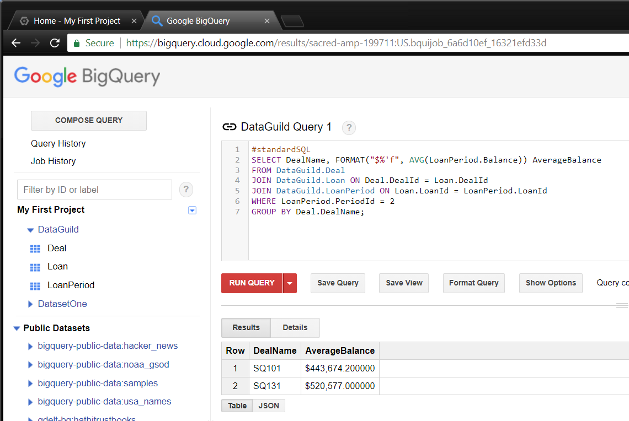
Simple Query – Query 1

Slide 19
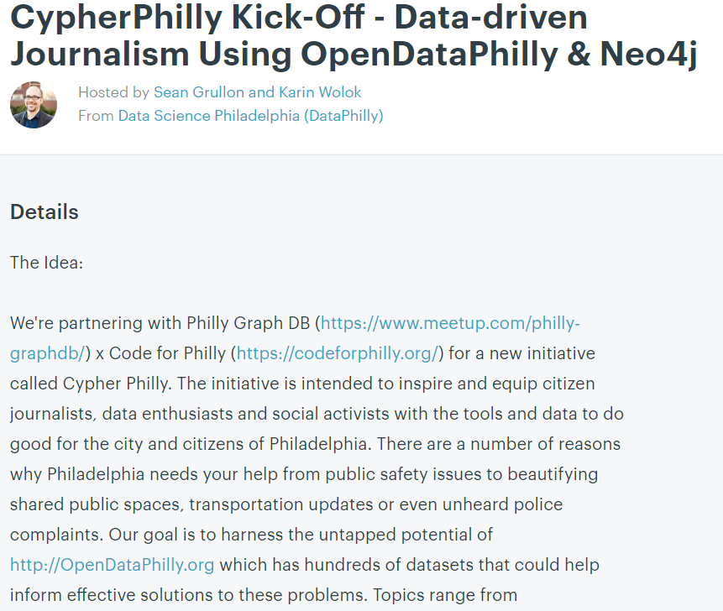
Why Do All This?

Slide 20
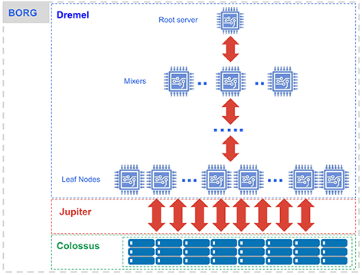
BigQuery Under the hood
Components of BigQuery:
Dremel - Query Engine
Jupiter - Network
Colossus - Distributed File System (Next Generation File system from Google after GFS)
Ref: https://cloud.google.com/blog/big-data/2016/01/bigquery-under-the-hood

Slide 21
Row Storage vs Columnar Storage
Row Oriented Storage
Traditional Database Table
A | B | C
A1 | B1 | C1
A2 | B2 | C2
A3 | B3 | C3
Column Oriented Storage

Slide 22
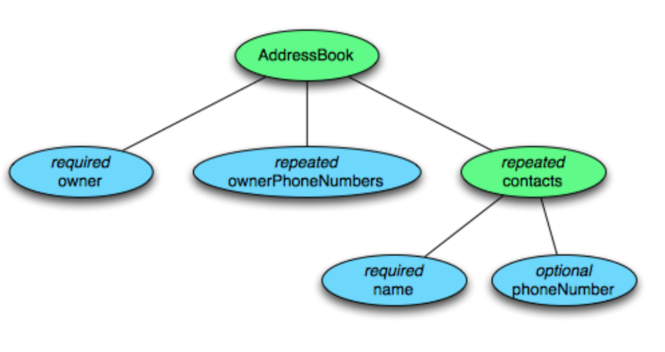
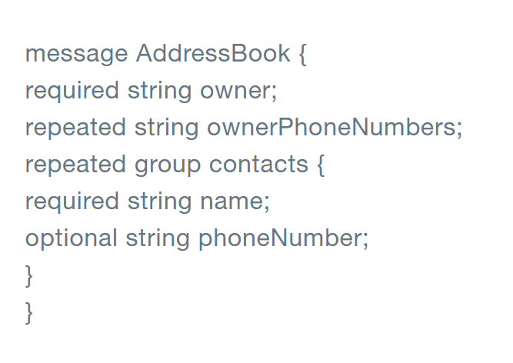
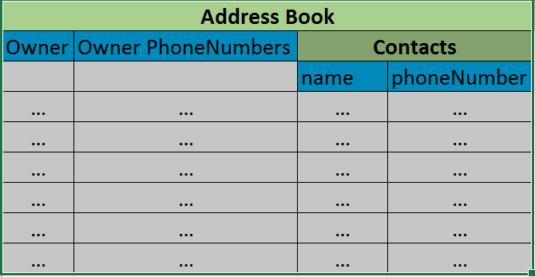
Columnar Storage
Schema
Schema as Tree Structure
Columnar Representation
https://blog.twitter.com/engineering/en_us/a/2013/dremel-made-simple-with-parquet.html

Slide 23
Encoding into Column Values
Encoding into Column Values
0
1
2
R
D
AddressBook{
Contacts: {
phoneNumber: “555 987 6543”
}
Contacts: {
}
}
AddressBook{
}
AddressBook
contacts
phoneNumber
0
2
contacts
1
1
AddressBook
0
0
Reference: https://blog.twitter.com/engineering/en_us/a/2013/dremel-made-simple-with-parquet.html

Slide 24
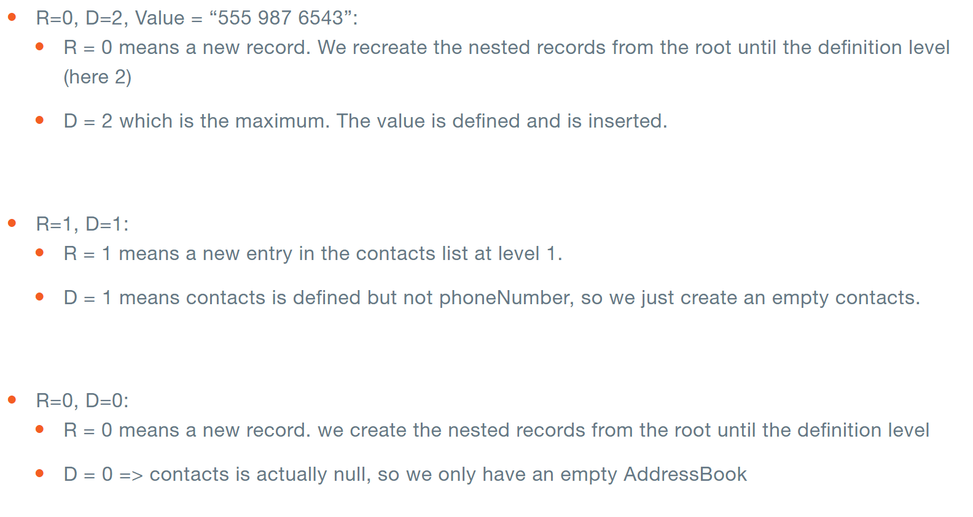
Record Reconstruction

Slide 25
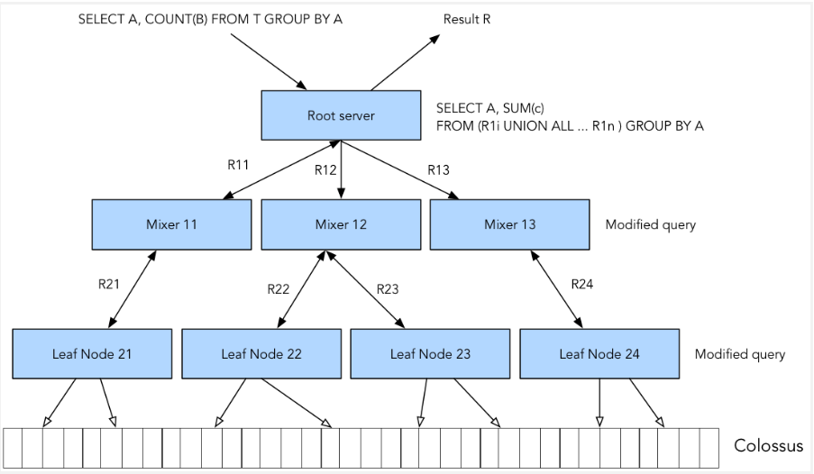
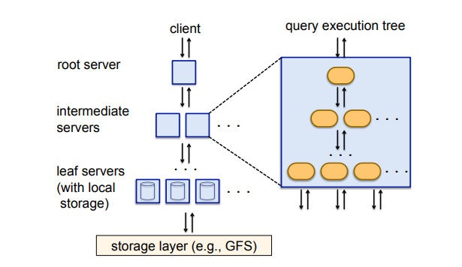
Query Execution
Query Execution
Multi-level Serving Architecture
https://panoply.io/data-warehouse-guide/bigquery-architecture/

Slide 26
Map Reduce vs BigQuery
Key Differences | BigQuery | MapReduce
What is it? | Query Service | Programming Model
Common Use-cases | Ad hoc trial-and-error interactive query | Batch Processing of large dataset
Response time | Usually in seconds-minutes | Takes Minutes-days
Complex data processing logic | Can’t handle | Yes (Map-Reduce programs)

